Slide 1
Modernising Legacy .NET Code Bases with NDepend
Goh Chun Lin www.linkedin.com/in/gohchunlin
.NET Foundation Member

Slide 2
NDepend: Why Static Code Analysis?
Bringing Down O2DES.NET Debt from 6.22% to 0.35%
Dashboard: Issues and Trends
Agenda
Code Dependency Graph and Code Metrics View
Integrating with GitHub Actions
What’s New: Full .NET 9 Support

Slide 3
O2DES.NET
A framework for object-oriented discrete event simulation.
Has not been actively updated on their GitHub public repository and it is still targeting at .NET Standard 2.1.
Goal: Migrate O2DES.NET to target at .NET 9.

Slide 4
O2DES.NET Milestone
July 2017
March 2022
Include a dynamic server based PathMover.
Chun Lin left the team.
O2DES.NET has not been actively updated on their GitHub public repository
March 2015
April 2019
Initial commit by Dr Li Haobin.
Riza Marhaban joins the team to migrate the framework to target at .NET Standard.

Slide 5
NDepend: Why Do We Need a Static Code Analysis?
A way of automatically checking our code for potential issues without running our apps.
NDepend is designed to help by performing a deep static analysis of the entire codebase.
NDepend also helps enforce good coding practices by pointing out issues like overly complex methods, dead code, or potential security vulnerabilities.

Slide 6
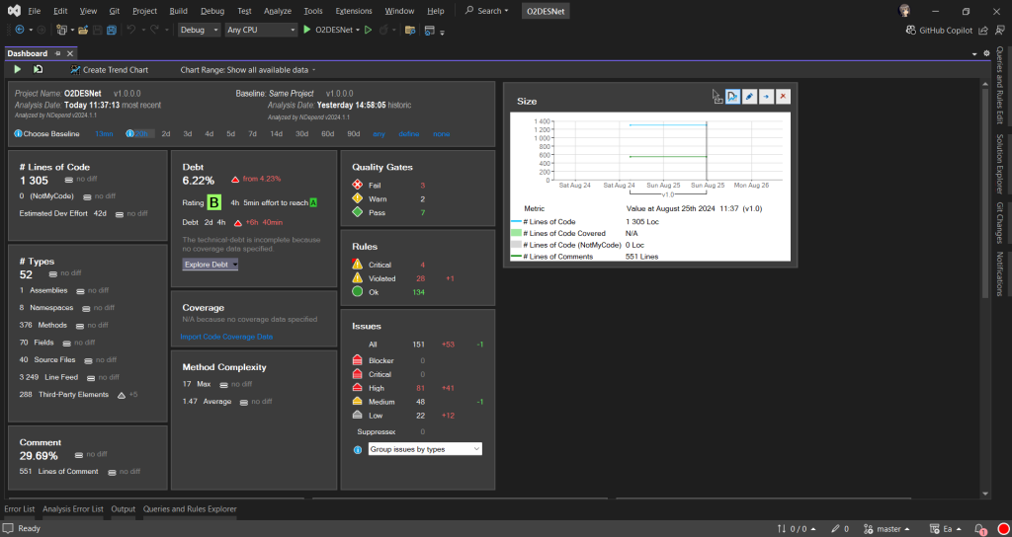
Bringing Down Debt from 6.22% to 0.35%
Comprehensive Dashboard
Presents critical insights in a visual and easy-to-understand format.
NDepend uses the Debt Ratio and Debt Rating, both of which are part of the SQALE method.
Debt Ratio: The percentage of effort needed to fix the technical debt compared to rewriting the code from scratch.
Debt Rating: A letter-based rating (A to E) derived from the Debt Ratio to give a quick overview of the severity of technical debt.

Slide 7
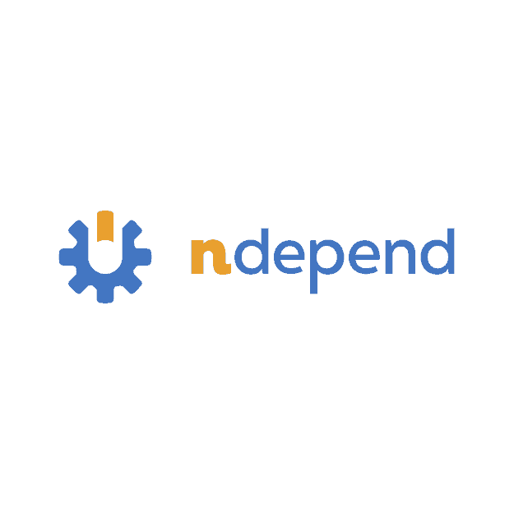
Demo: Dashboard
Bringing Down Debt from 6.22% to 0.35%

Slide 8
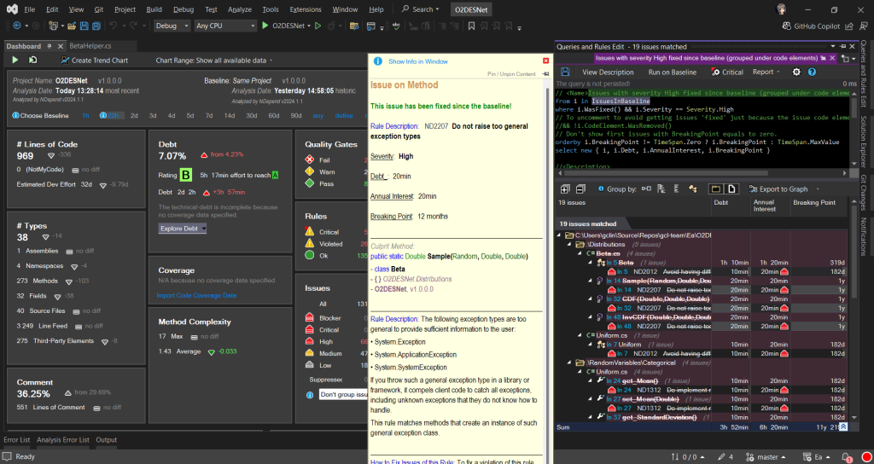
Issues and Trends (1/2)
Issues
Indicates the number of critical rules violated and critical issues to solve.
When we first set up an NDepend project, the very first analysis of our code becomes the “baseline.”
As we continue to work on the project, future analyses will be compared against this baseline.
When we click on the numbers, we will be shown the corresponding issues.

Slide 9
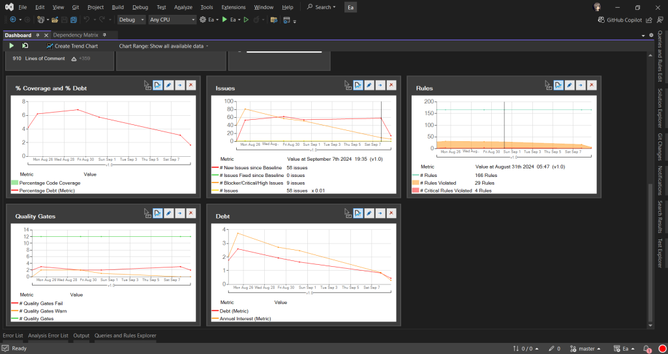
Issues and Trends (2/2)
Trends
By default, the dashboard also comes with some helpful trend charts. These charts give us a visual overview of how our codebase is evolving over time.
Help us to track important metrics, like code coverage, issues, or technical debt, and show how they change with each analysis.

Slide 10
Demo: Issues and Trends
Baseline, Issues, and Trends

Slide 11
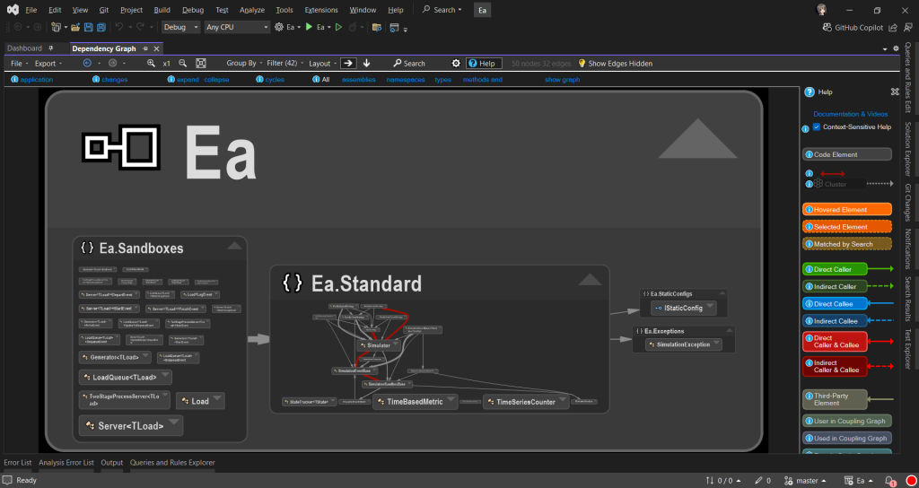
Code Dependency Graph (1/3)
Code Dependency Graph
Visually represent the relationships between different components such as namespaces and classes within our codebase.
Show us how the different parts of the codebase are connected.
The insight is to plan how to split components, which will then make the code easier to manage.

Slide 12
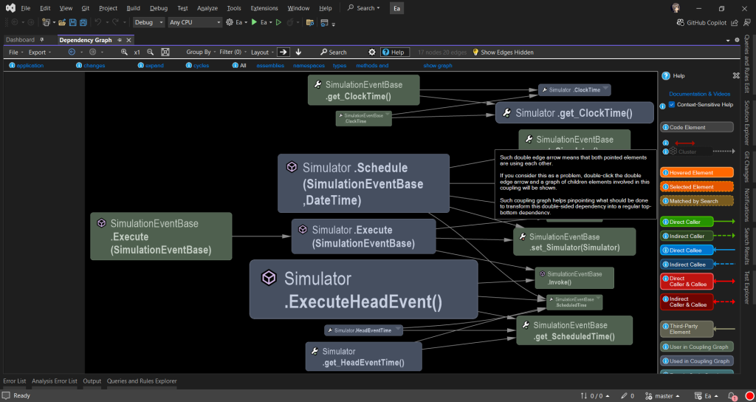
Code Dependency Graph (2/3)
Coupling Graph
To further investigate the classes, we can double click the edge between those two classes.
if multiple methods are too intertwined, it might be time to extract common logic into a new class or interface.

Slide 13
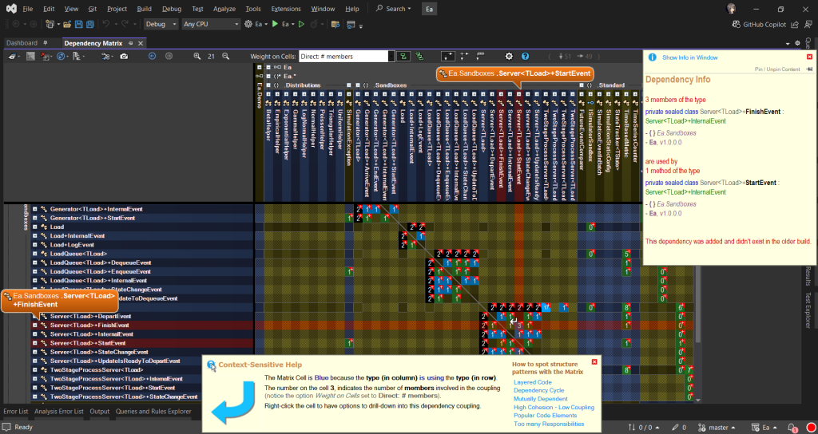
Code Dependency Graph (3/3)
Dependency Matrix
Visualise the dependencies between namespaces, classes, or methods.
A number in a cell at the intersection of two elements indicates how many times the element in the row depends on the element in the column.
Having large numbers indicating the two methods are highly dependent on each other.
If there is a cycle in the codebase, there will be a red square shown on the Dependency Matrix. We then can refactor by breaking the cycle.

Slide 14
Demo: Code Dependency Graph
Code Dependency Graph, Coupling Graph, Dependency Matrix

Slide 15
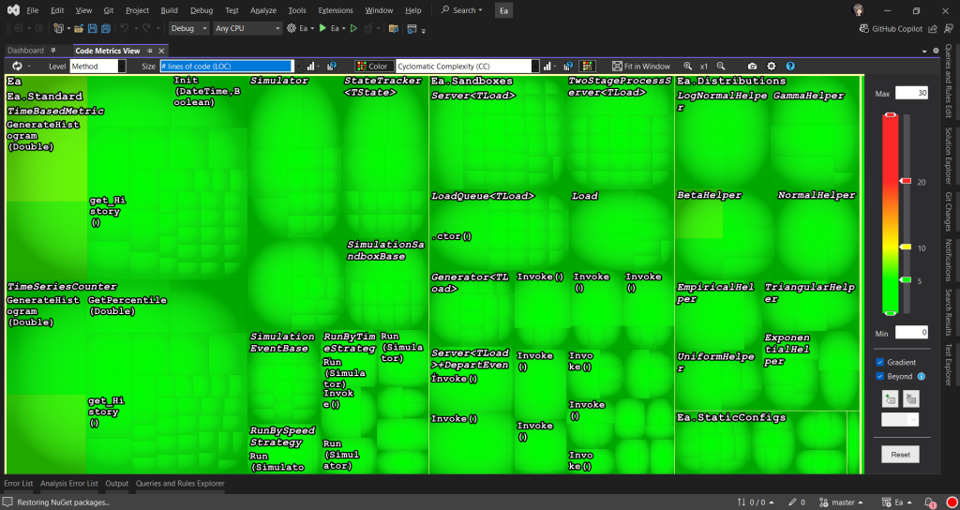
Code Metrics View
Code Metrics View
Each rectangle represents a method.
The area of a rectangle is proportional to metrics such as the # lines of codes (LOC), cyclomatic complexity (CC), of the corresponding method, field, type, namespace, or assembly.
Enable us to navigate our codebase and prioritise areas that require refactoring by spotting those methods that are too big and too complex.

Slide 16
Demo: Code Metrics View
Code Metrics View

Slide 17
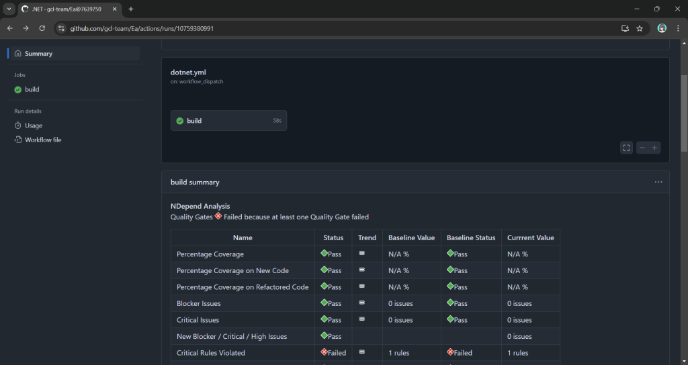
Integrating with CI/CD
GitHub Actions
NDepend integrate well with several CI/CD pipelines.
NDepend comes with Quality Gates that enforce standards such as unfixed critical issues.
Quality Gates are predefined sets of code quality criteria that our project must meet before it is considered acceptable for deployment.

Slide 18
Demo: Integrating with CI/CD
GitHub Actions

Slide 19
Full .NET 9 and C# 13 Support
Introducing NDepend v2024.2

Slide 20

Get .NET 9
Download .NET 9 aka.ms/get-dotnet-9

Slide 21
Resources
https://www.ndepend.com/
http://www.o2des.net/
NDepend: The .NET Code Quality and Security Tool
A C# framework for object-oriented discrete event simulator
https://www.ndepend.com/whatsnew
https://cuteprogramming.blog/2024/09/12/from-legacy-to-net-8-migrating-with-ndepend/
What’s new in NDepend v2024.2
Blog post about my O2DES.NET migration journey with NDepend

Slide 22
Thank you

